Slide 1
Health & Wellness Website
By Dalton Schnieders

Slide 2
Project Description
Problem: Professional Engineering Consultants has a health and wellness program for employees. Current data collection is done via hundreds of Excel spreadsheets that are manually collected and data compiled once a quarter.
Solution: A website that collects data from users and then presents that data in useful ways for both employees and admins

Slide 3
Requirements
Website
Sign in page
Welcome/home page
Data collection page
Data presentation page
Incentive selection
Features
Easily collect data on current progress
Display collected data of employee’s progress on the website

Slide 4
Tools
Database
SQLite3
Website
Javascript
NodeJS
Bootstrap
JQuery
Express
Charts
Google Visualizations
Notes:
-SQlite3 is lightweight, easier to use than Microsoft SQL Server
-Javascript used for client side scripting node js for server side - querying database and sending information to the client
-Bootstrap as css framework
-JQuery and AJAX to make calls from client to server
-Express to manage everything on my server

Slide 5
Data Sources
Users
Users will log their progress which will then store data into the database
Users can watch their progress as they meet goals and see how far they are from the next goal
Admins
See which users have met certain thresholds
See how many users are using the program
Can see “what works”

Slide 6
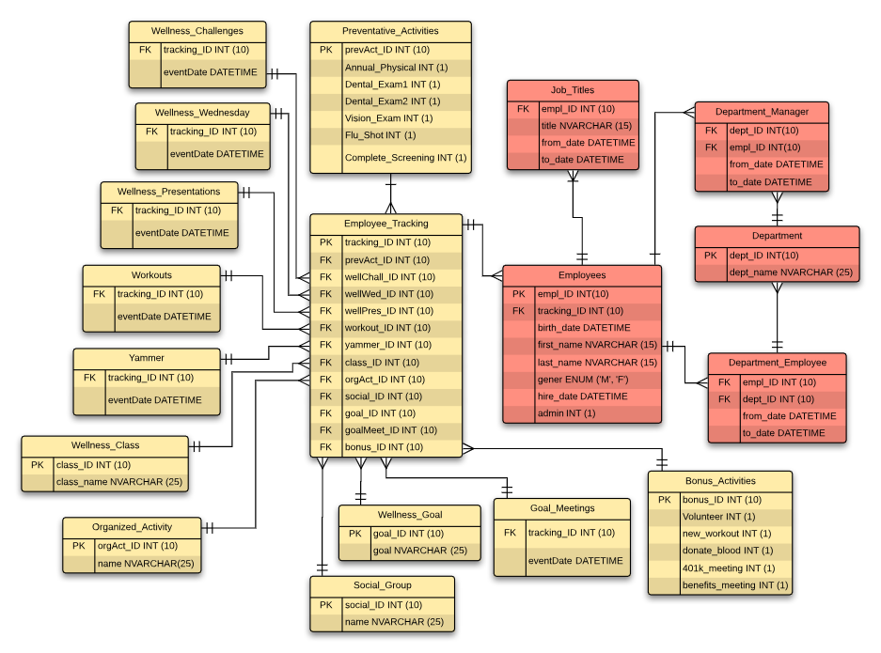
Original
DB Design

Slide 7
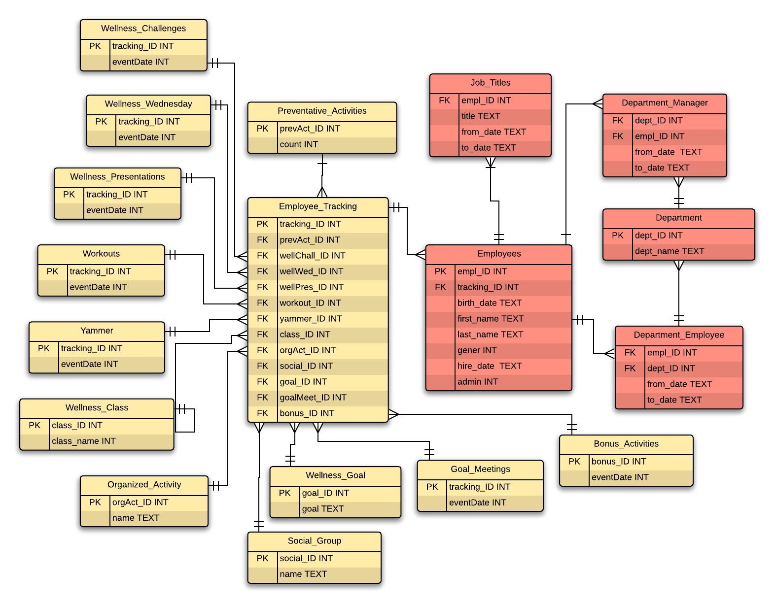
Current
DB Design

Slide 8
Demo

Slide 9
Struggles
Web Design in general
CIS 526 and CIS 562
Interaction between client and server
Struggled with async/sync functions

Slide 10
Improvements
Error checking and troubleshooting
Prevention against SQL injection attacks
User authorization

Slide 11
Future features
Integrate with Office 365
Admin site
Get more useful information
Less static, more dynamic

Slide 12
Questions?

